Slide 1
Presented By:
Judy Robinett
Power Networks That Help You Achieve Your Greatest Potential

Slide 2
The richest people in the world look for and build NETWORKS, everyone else looks for work.
Robert Kiyosaki

Slide 3
NET
WOR
K
TH

Slide 4
If you want to go fast, go ALONE.
If you want to go far, go with OTHERS.
African proverb

Slide 5
Get out
there
and
get
connected
Guy Kawasaki

Slide 6
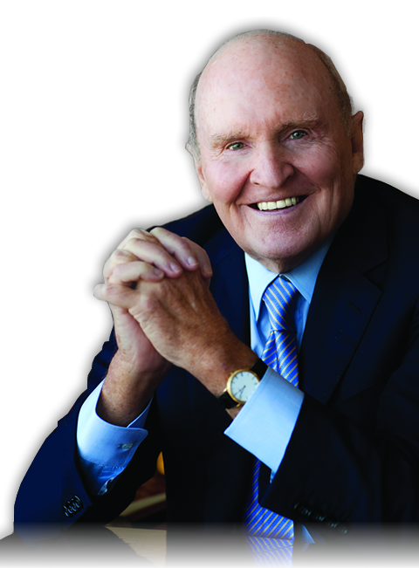
Forget an
MBA.
Learn to
NETWORK
Jack Welch

Slide 7
First you need to know who you need to know.
Then you need to get to know them.

Slide 8
Network Intelligence
Understand ASSETS
Get INTRODUCED
Track RISK
Reid Hoffman
The Startup of You

Slide 9
If you always do what you always did …
Always change a LOSING GAME
David Posen

Slide 10
What’s holding you back?
Confront FEARS
Challenge ASSUMPTIONS
Change BELIEFS
Create RELATIONSHIP CAPITAL

Slide 11
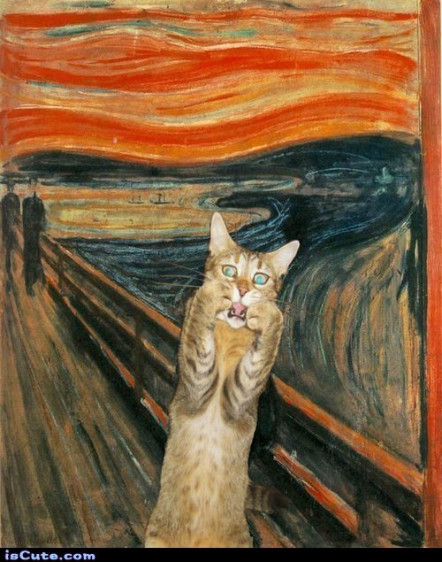
Rethink Fear!
Pachad
The worst case
Fight or Flight
Panic or Terror
Yirah
Awe has an element of fear
Feeling that overcomes us when we inhabit a larger space

Slide 12
CHANCE is always powerful.
Let your hook be always cast; in the pool where you least expect it, there will be a fish.
Ovid Roman poet (43 BC - 17 AD)

Slide 13
Rethink Assumptions
Shy
Strangers
Silver Spoon

Slide 14
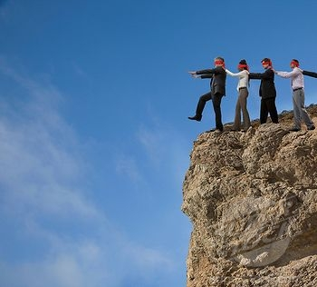
Errant ASSUMPTIONS lie
at the root of
every failure.
Alex Mackenzie
ASSUMPTION is the
mother of all screw-ups.
Wethern’s Law of Suspended Judgment

Slide 15
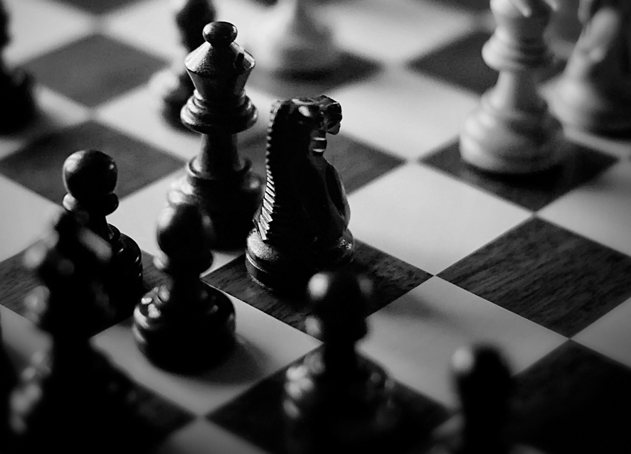
Four Critical Resources
Opportunities
Information
Money
Connections

Slide 16
Get In The Game
“You have to learn the rules of the game. And then you have to play better than anyone else.”
Albert Einstein

Slide 17
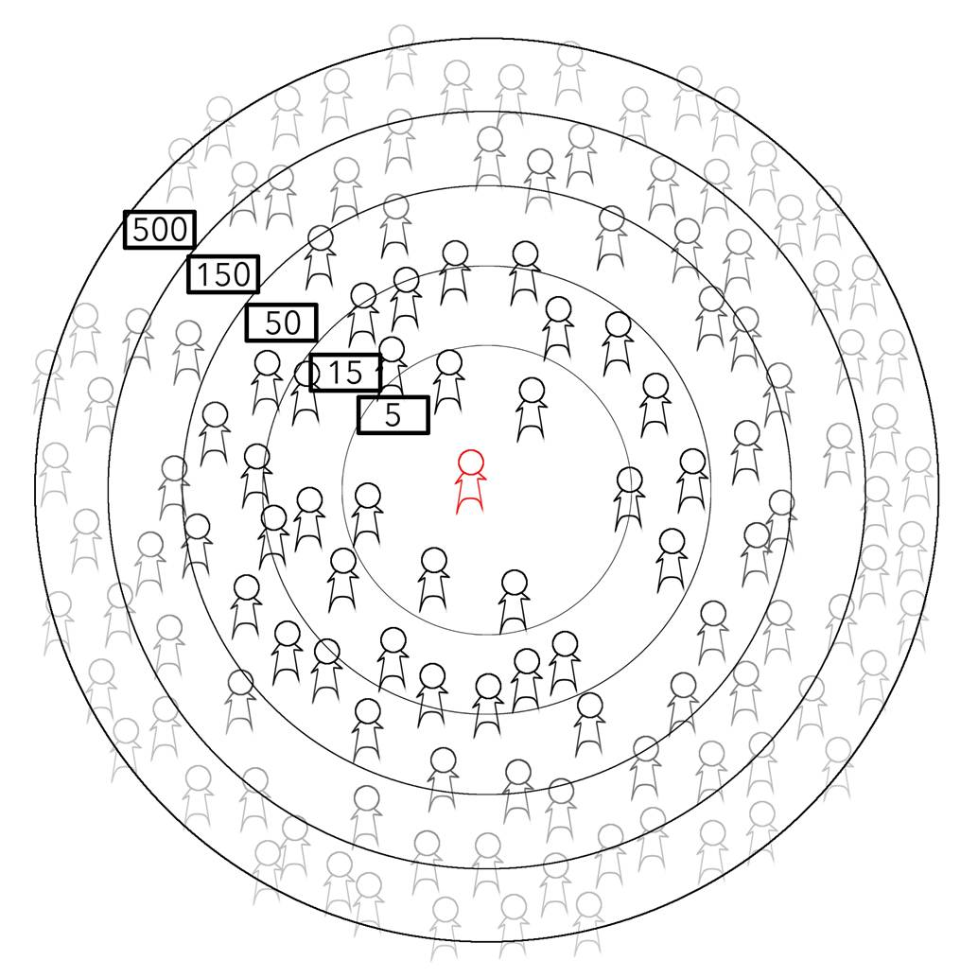
Your Social Circle
Bigger ≠ Better
Goal is Quality-- Robust, Deep, and Wide
Source: Grouped: How small groups of friends are the key to influence on the social web - Paul Adams

Slide 18
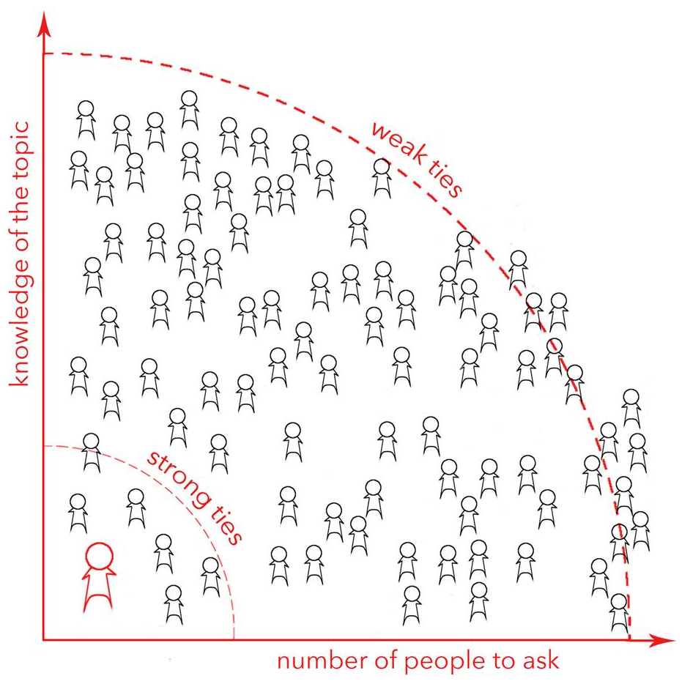
Focus on 50
Source: Grouped: How small groups of friends are the key to influence on the social web - Paul Adams

Slide 19
Strategic Networking: Know your NEEDS
What is your goal?
Grow Revenues
Find Strategic Alliances
Find a Job

Slide 20
Who do you need?
How reach them?
Who? | Why? | How?

Slide 21
Groups, associations
Curated events
Meetup.com (90K interest groups in 45,000 cities)
Opportunity | Information | Connections | Money

Slide 22
Are attendees potential clients or are they smarter than you?
90 % networking events
waste of time

Slide 23
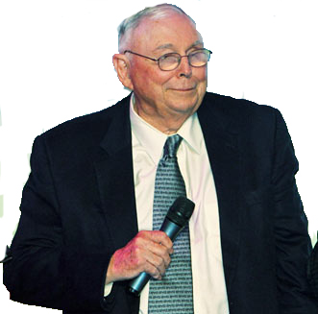
100 PEOPLE
can’t live without
5
no
interest
20
wait
and
see
75
Charlie Munger

Slide 24
Social Media Limitations
 | 25 new friends a day
 | 250 people a day 14% use regularly and only 3% saw results
 | Too many links = flag 7% usage and only 4% felt it had potential
 | 30% spent time on LinkedIn, 41% saw results
The Complete Idiot’s Guide to Social Media Marketing by Jennifer AbernethySources: Wall Street Journal & Vistage Study

Slide 25
SKILL SET
Listen | Eyes, Ears, Heart
Story | Be You, Be Real
Ask | Date First
Values | Empathy
Small Message, Big Impact: The Elevator Speech Effect by Terri L. Sjodin

Slide 26
Almost a Psychopath
Charming with an answer for everything
Lack of empathy
Lie
Cunning and manipulative
Rationalize morals for self-interest
Blame others for their hurt
Ronald Schouten, MD, JD, Harvard Medical School and James Silver, JD

Slide 27
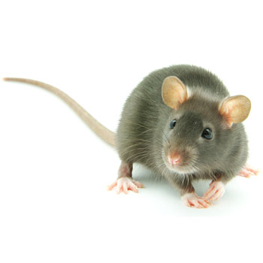
You’re a mouse studying to be a rat.
Wilson Mizner

Slide 28
If there is something to gain
and nothing to lose by asking,
by all means ask.
W. Clement Stone

Slide 29
Three Golden Questions
1. How can I help you?
2. Who else do you know that I should talk to?
3. What other ideas do you have for me?

Slide 30
Power Connection Map to Success
ECOSYSTEM
Room
S
U
C
C
E
S
S
NEEDS
People
Tasks
Wide
Deep
Robust

Slide 31
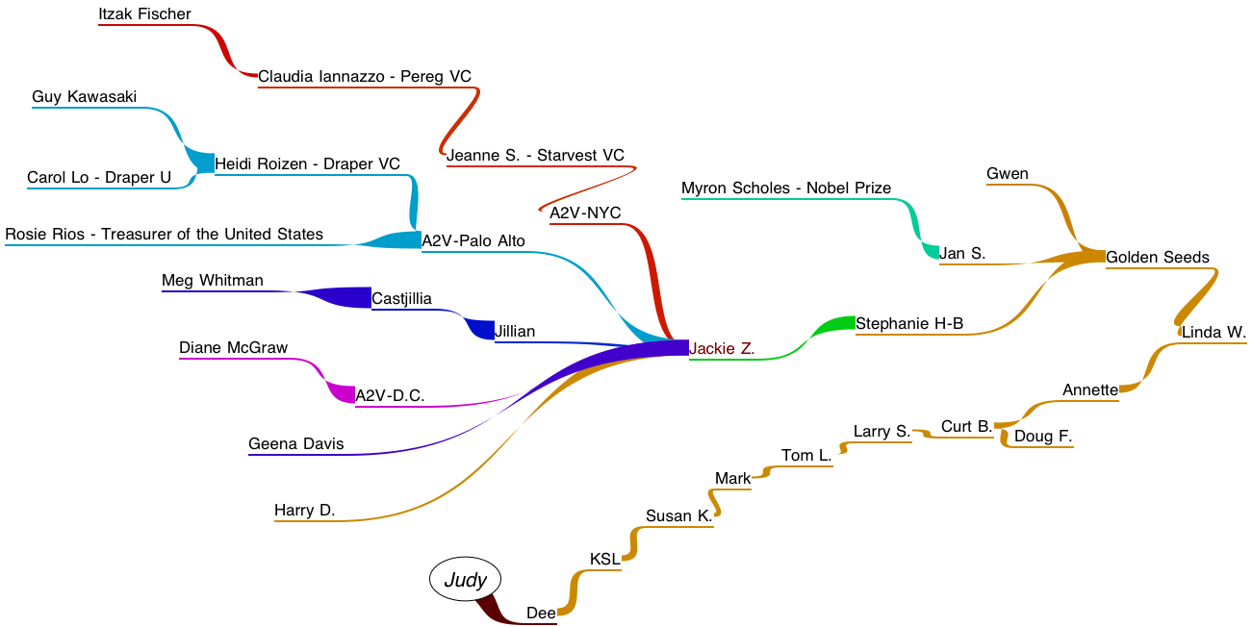
2
3
4
1

Slide 32
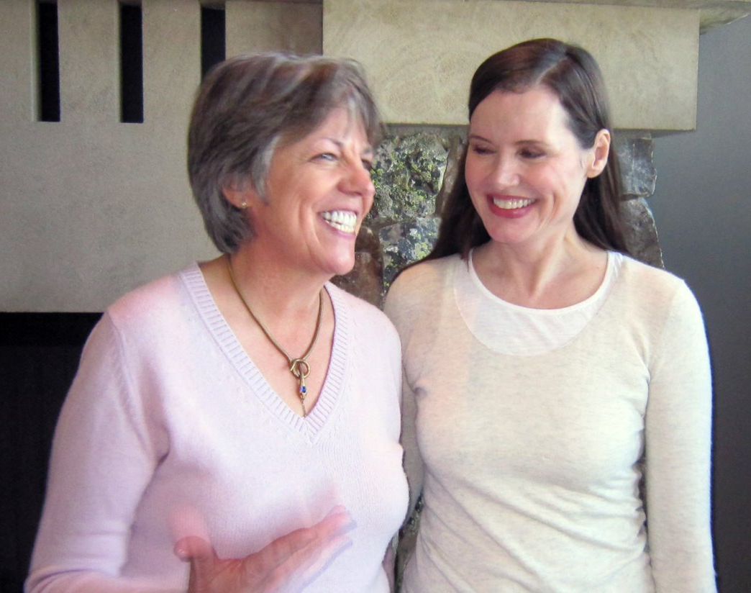

Slide 34
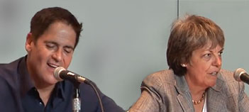

Slide 35
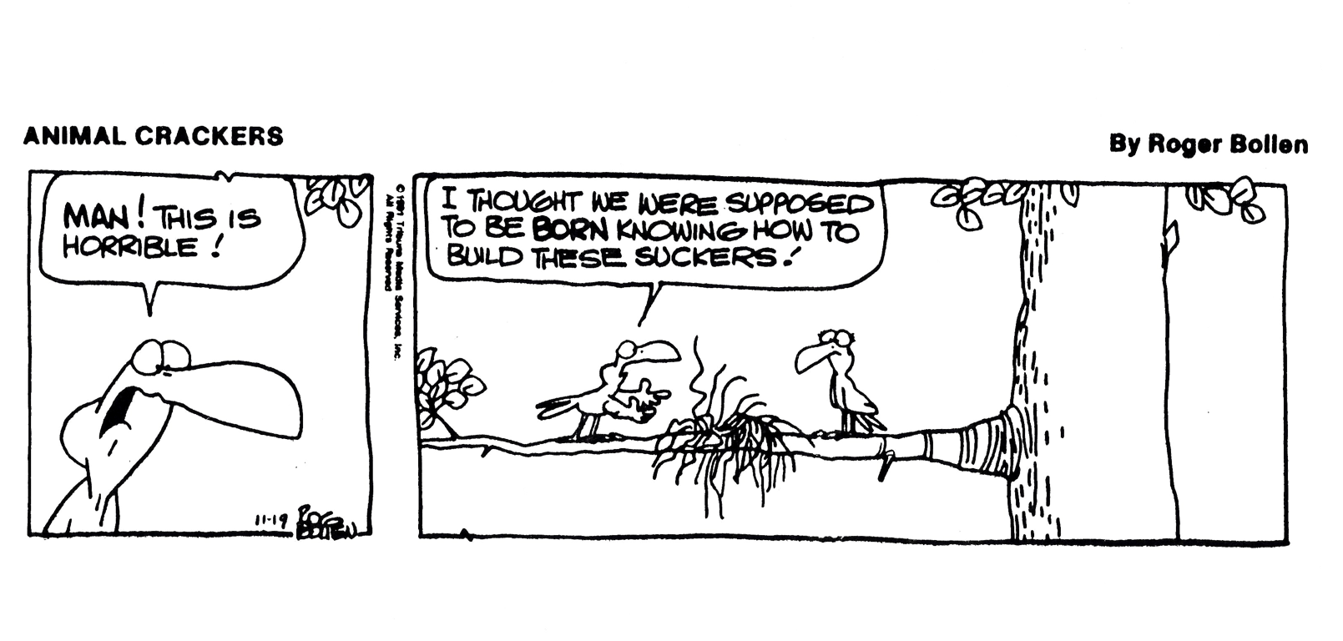
Judy Robinett
judy@judyrobinett.com
@judyrobinett
801-582-0717

